Slide 1


Slide 2


Slide 3


Slide 4


Slide 5


Slide 6


Slide 7


Slide 8


Slide 10
The following slides are provided for you should you prefer to use a different Bible version for the included verse.

Slide 11


Slide 12
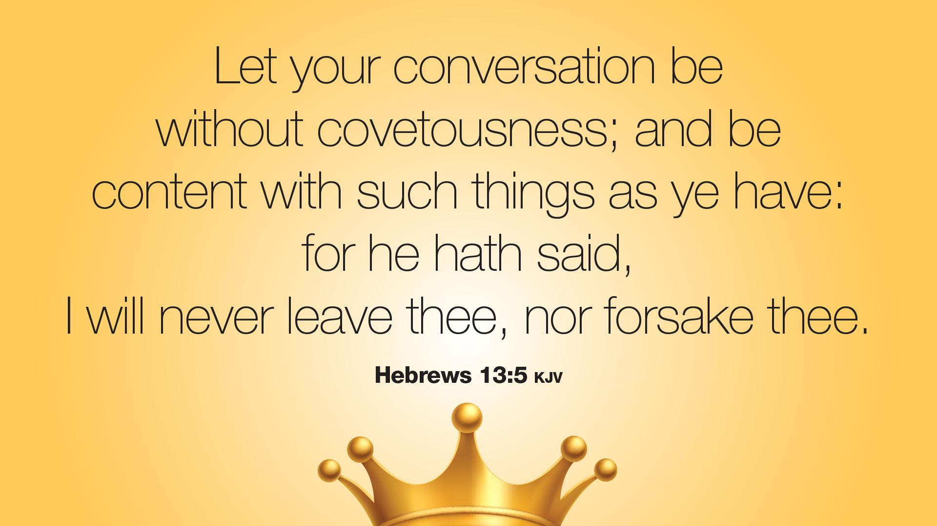

Slide 13


Slide 14


Slide 15


Slide 16


Slide 17


Slide 18


Slide 19


Slide 20


Slide 21


Slide 22


Slide 23
The additional slides below are provided so the PowerPoint can be adapted to best fit your needs.

Slide 24


Slide 25


Slide 26


